Slide 1
GunDamn
Group 7:
Aaron Willis, Andrew Edwards, Charles Simms, James Elugbemi, Matthew Braden

Slide 2
Mechanics
Health that dwindles down every time the player is hit. Once the health is gone, the player loses and has to restart again.
Invulnerability for the player a few seconds after being hurt.
The player moves with WASD or arrow keys to dodge bullets shot at them.
The player shoots bullets with Z or left mouse button.
Bosses shoot a variety of bullet patterns that hurt the player.
Notes:
Charles

Slide 3
User Interface
The game starts with a main menu title screen. There are three options to choose from (play, help, and quit).
The play button allows the player to fight the first boss.
The help button shows information on how to play the game.
The quit button quits the application.
If the player dies during gameplay, a death screen will appear allowing the player to either retry the boss or quit. If the player wins the level, the player is allowed to play the next level or quit to main menu.

Slide 4
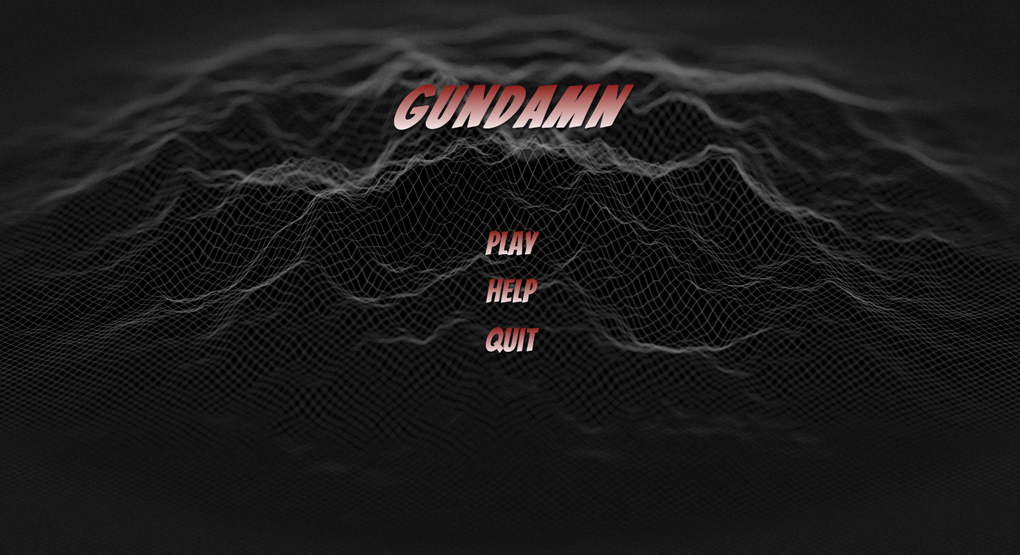
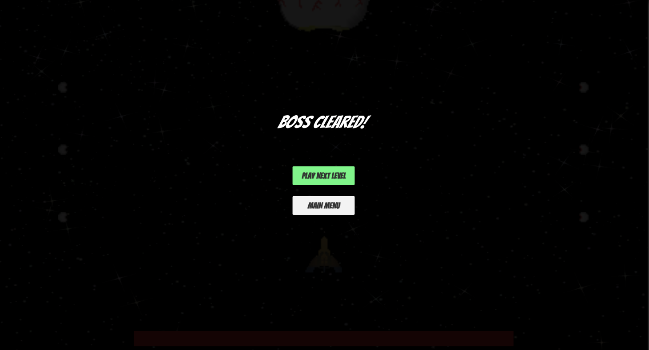
Main Menu and Win Screen (Game View)

Slide 5
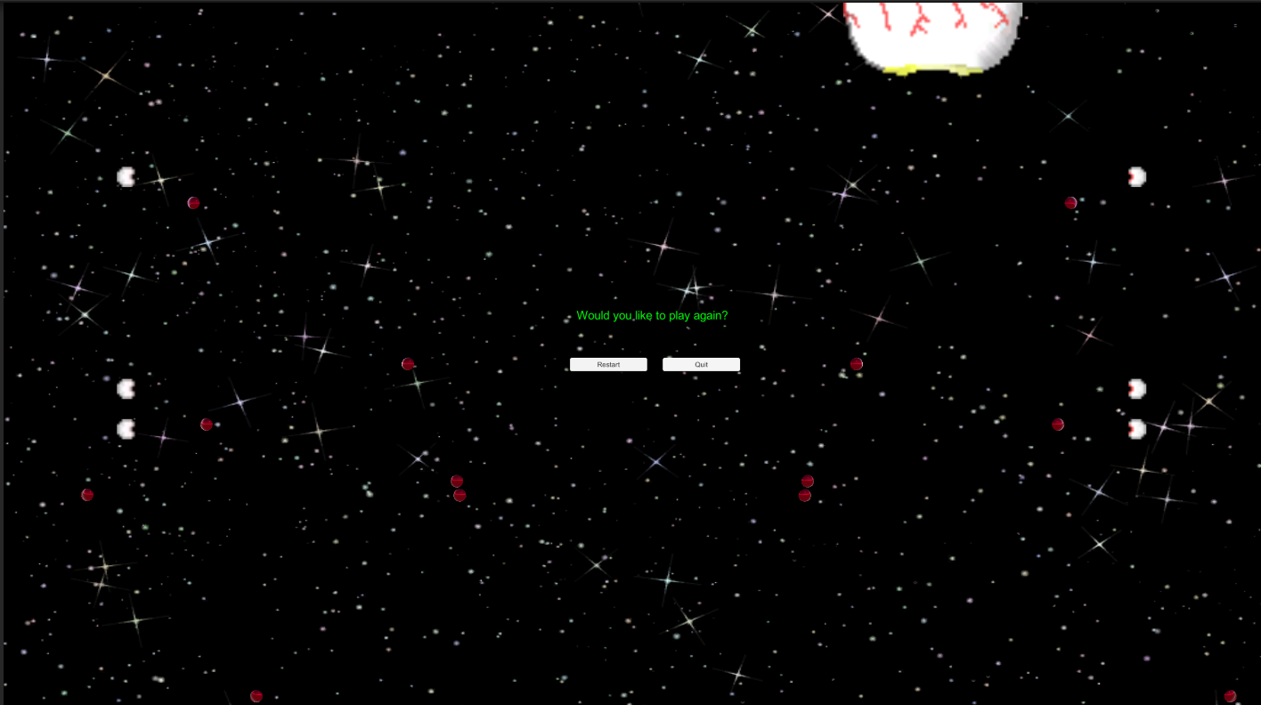
Death Screen (Game View)

Slide 6
Key Features
The game is viewed from a top-down perspective reminiscent of old shoot ‘em up games like Space Invaders.
Bosses inhabit the two scenes prepared where you have to survive and fight to win.
Enemy patterns are unique to the specific enemy.
Notes:
Andrew

Slide 7

Boss: Eye
The Eye has a decent size pool of health and starts to turn red when low on health.
Shoots bullets in a half circle pattern outward every few seconds.
A large beam charges up after 20 seconds and hurts the player if in the beam’s range.
Moves from left to right of the top of the screen.
Minions occupy the left and right screen that shoot bullets towards the player.
Notes:
Matt

Slide 8


Boss: Chitin Caterpillar
The Chitin Caterpillar has a larger pool of health due to its armored exterior.
Follows a track around the screen from top left, top right, bottom right, and bottom left respectively.
Shoots bullets in a swirl that arrive where the player used to be.

